Slide 1

AutoDine– Smart Restaurant Table-to-Kitchen Coordination Platform using IoT
TEAM MEMBERS
1.Udhaya S [126005049/EEE]
2.Srikar K [126005026/EEE]
3.Jathin P [126005035/EEE]
PROJECT GUIDE
Shanmugham K
Asst.Professor - II
SEEE, SASTRA

Slide 2
OUTLINE OF PRESENTATION
Introduction
Literature Review
Objective
Research Gap
Methodology
Timeline
Individual focus
Reference

Slide 3
INTRODUCTION
Many restaurants still use manual ordering and billing, causing delays, errors, and poor peak‑hour service.​
IoT and embedded systems enable direct table‑to‑kitchen communication, reducing waiting time and miscommunication.​
AutoDine provides a smart, session‑based table system that links ordering and billing to streamline restaurant operations.

Slide 4
LITERATURE REVIEW
PUBLISHED YEAR | METHODOLGY | RESULTS OBTAINED | DRAWBACKS
2018 | IoT-based food ordering system using microcontroller, wireless communication between table unit and kitchen unit. | Reduced order processing time and improved order accuracy compared to manual ordering. | Billing control and prevention of unpaid exits were not addressed.
2019 | Embedded system-based smart restaurant using digital menu display and wireless data transfer. | Minimized human intervention and improved customer satisfaction. | System lacked real-time session management and secure billing workflow.
2020 | GSM-based alert and notification system integrated with embedded controller. | Enabled real-time alerts and notifications using GSM communication. | Used only for alerts; ordering and billing integration was not included.
2021 | IoT-enabled restaurant management system with centralized server for order handling. | Improved coordination between tables and kitchen, reduced service delay. | Did not provide mechanisms to prevent dine-and-dash scenarios.

Slide 5
OBJECTIVE
To develop an IoT‑based system for direct, wireless communication between customer tables and the kitchen.​
To automate ordering and billing, minimizing human errors and manual workload.​
To enforce session‑based billing so that each table can be reset only after successful payment.​

Slide 6
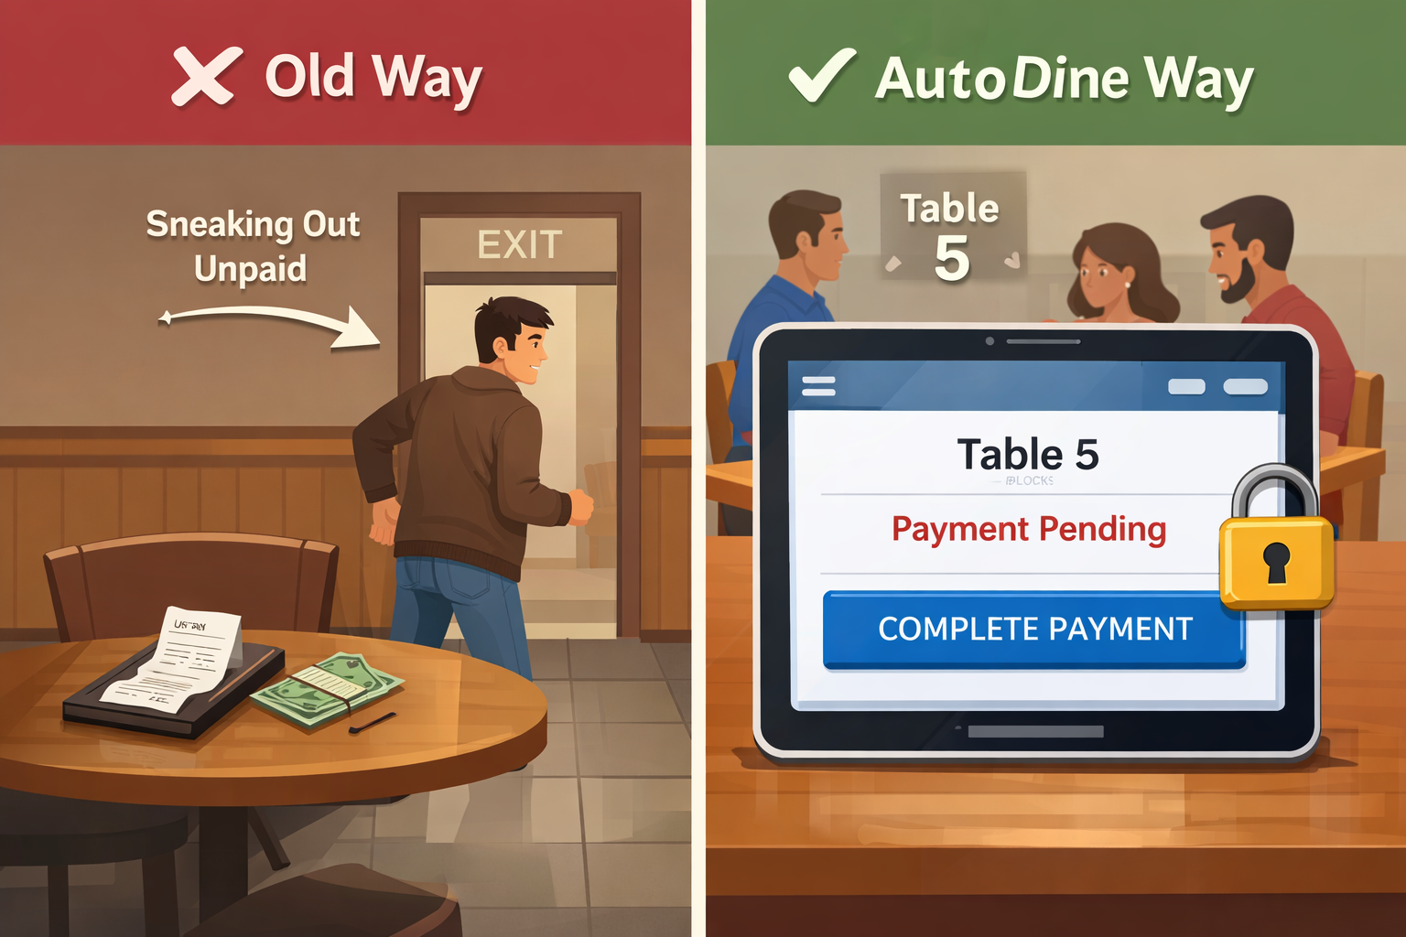
RESEARCH GAP
Current Gap: Restaurants rely on CCTV, guards, or card holds to prevent dine-and-dash, but these are reactive, expensive, and harm the dining experience. There is no system that digitally enforces payment at the table level.
AutoDine Solution: AutoDine assigns each table a unique ESP32-based session ID and keeps the table locked in the system until payment is confirmed by the cashier. The table cannot reset or close without payment—protecting revenue without cameras or security staff.

Slide 7
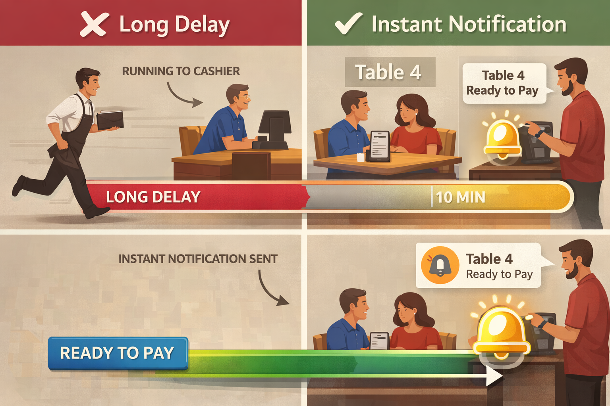
RESEARCH GAP(CONTINUES)
Current Gap: Ordering and billing are handled by separate systems, forcing waiters to run between tables and counters. This delay frustrates customers and increases walkouts during peak hours.
AutoDine Solution: AutoDine unifies ordering and billing into a single table device. When customers press “Ready to Pay,” the bill instantly reaches the cashier, eliminating waiter dependency and enabling fast, frictionless payments.

Slide 8
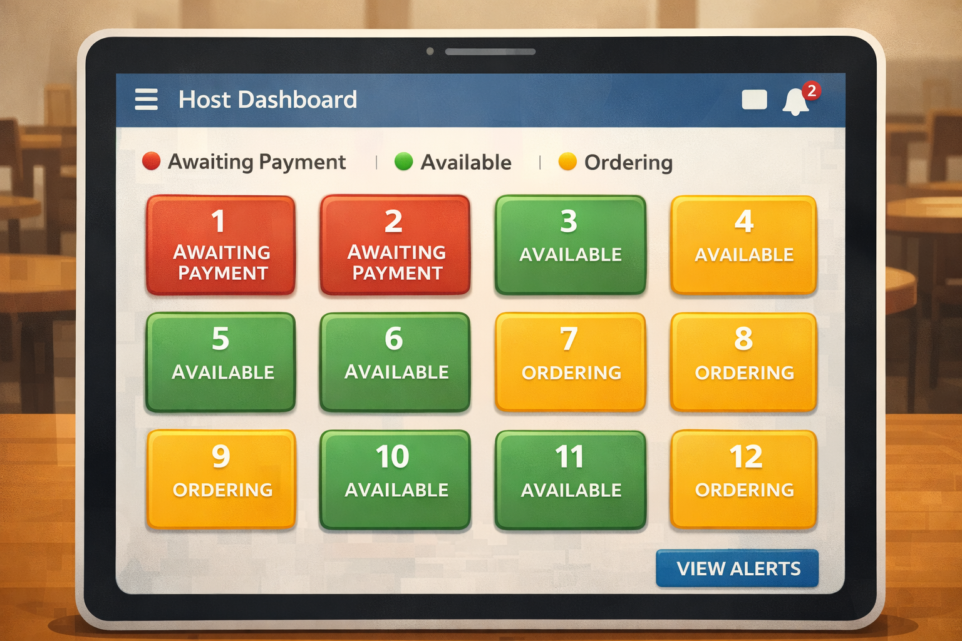
Research Gap(continues)
Current Gap: Even with smart systems, table status is manually tracked and disconnected from live orders, leading to double seating, missed payment requests, and operational chaos.
AutoDine Solution: AutoDine provides a live host dashboard showing every table’s real-time state—from ordering to payment completion. Managers get instant visibility, enabling perfect seating decisions and faster staff response.

Slide 9
METHODOLOGY
1. System Architecture
ESP32 table units, host/cashier system, central server. Real-time order, billing, payment tracking.
2. Session Initialization
Unique session ID generated per table. Status "Ordering." All actions linked to session.
3. Order & Billing Integration
Direct ordering via table unit. Real-time bill updates. No manual order collection needed.
4. Payment Lock Mechanism
Table locked after serving. Status "Awaiting Payment." Cannot reset without payment verification.
5. Ready to Pay Notification
Customer presses "Ready to Pay." Instant cashier notification. Removes billing delays.
6. Host Dashboard Monitoring
Color-coded table status: Yellow=Ordering, Red=Awaiting Payment, Green=Available.

Slide 10
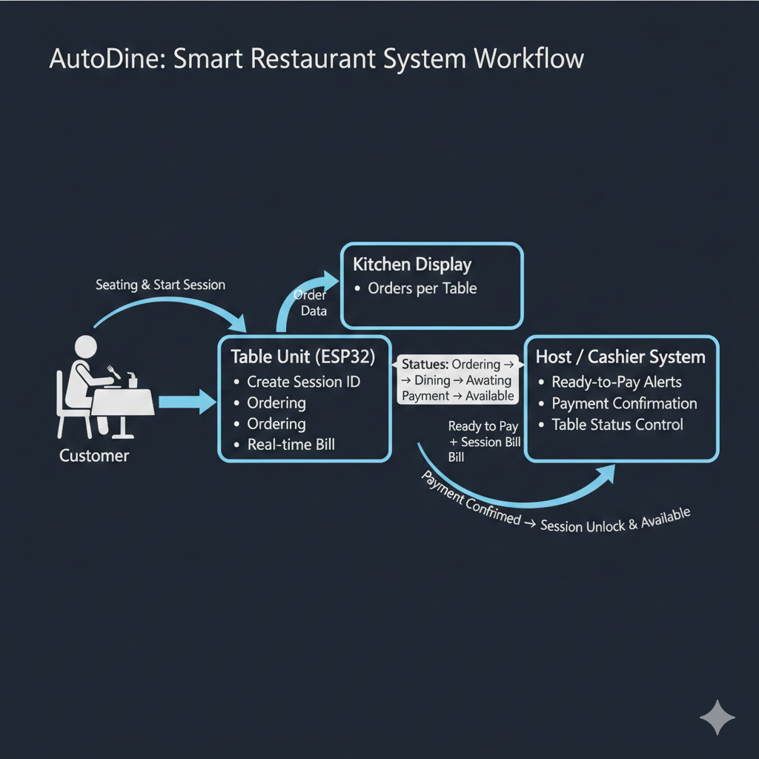
METHODOLOGY(CONTINUES)
7. Payment Verification & Closure
Cashier confirms payment. Session unlocked. Table resets to "Available" for revenue protection.

Slide 11
TIMELINE
First Review:
Design and development of the AutoDine system architecture, interfacing ESP32 with table units, and implementation of table-to-kitchen communication and session control logic.
Zeroth Review:
Overview of the AutoDine project, identification of the problem in restaurant ordering and billing, understanding the system objectives, and finalizing the IoT-based solution approach.
System integration, testing with multiple tables, validation of billing control mechanism, and improvement of outputs based on review feedback.
Second Review:

Slide 12
INDIVIDUAL FOCUS
Udhaya S [126005049] Focused on understanding the overall problem statement and studying existing IoT-based restaurant automation systems. Also contributed to UI/UX design and frontend development of the web-based ordering display, focusing on a simple, clean interface for easy food ordering. Contributed to requirement analysis, literature review, and identifying limitations in current ordering and billing methods.
Srikar K [126005026] Involved in system design and hardware planning of the IoT-based restaurant automation system. Contributed to defining the table-to-kitchen communication flow, hardware component selection, and overall system architecture, ensuring reliable interaction between the ordering display and backend units.
Jathin P [126005035] Responsible for ESP32 firmware development and integration of table and host units. Implemented session-based billing control logic, handled communication between multiple tables, performed system testing, and carried out overall system validation.

Slide 13
REFERENCE PAPERS
[1] S. Karthik, R. Suresh, and others, “IoT Based Smart Restaurant Management System,” International Journal of Engineering Research and Technology (IJERT), vol. 7, no. 4, pp. 1–5, 2018.
[2] P. Venkatesh and M. Prakash, “Smart Ordering System Using Embedded Systems and Wireless Communication,” International Journal of Computer Applications (IJCA), vol. 179, no. 12, pp. 15–19, 2019.
[3] A. R. Al-Ali and M. Q. Shah, “GSM Based Alert System Using Microcontroller,” in Proceedings of the IEEE International Conference on Embedded Systems, pp. 45–50, 2020.
[4] M. Conti, A. Dehghantanha, and others, “Lightweight Authentication and Session Management for IoT Systems,” IEEE Internet of Things Journal, vol. 8, no. 6, pp. 4689–4701, 2021.

Slide 14
Thank you

